Slide 1

Installing Python and Visual Studio Code on Windows

Slide 2
Before installation
Make a local folder for your future Jupyter notebook files – for instance in the same folder as your lecture notes etc.

Slide 3
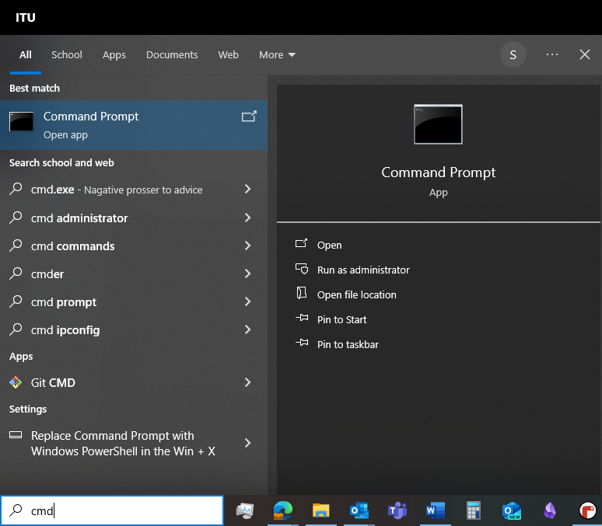
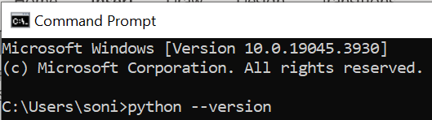
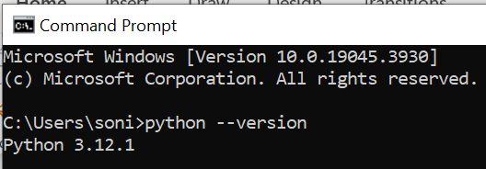
Check If you have an existing python installation
Open the command prompt by typing “cmd” in the Windows search field
Type:
python --version
and press enter
This should display the version of python if it's installed correctly. If not, install python (next slide)

Slide 4
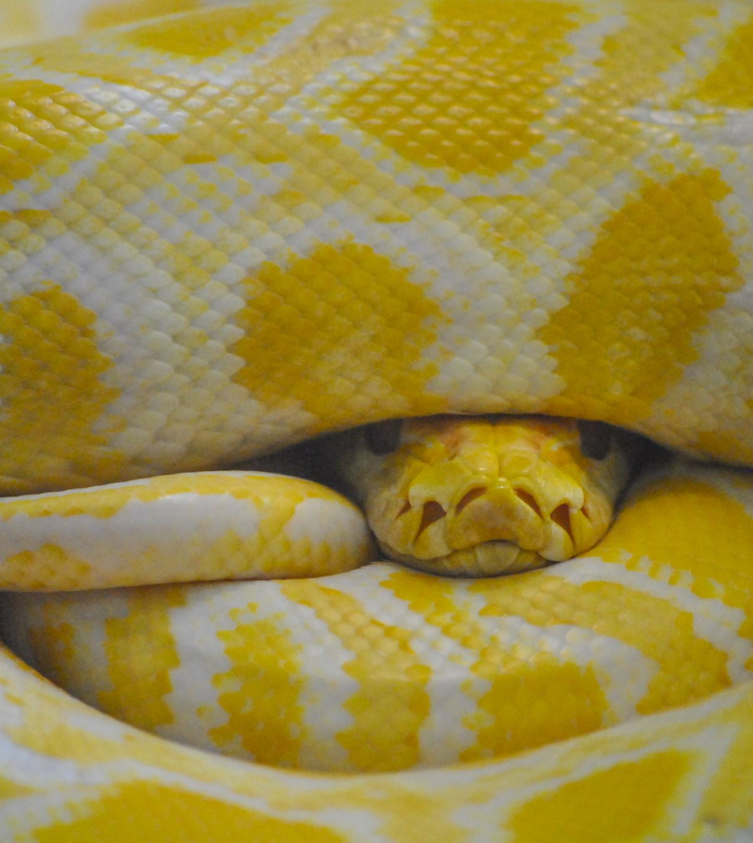
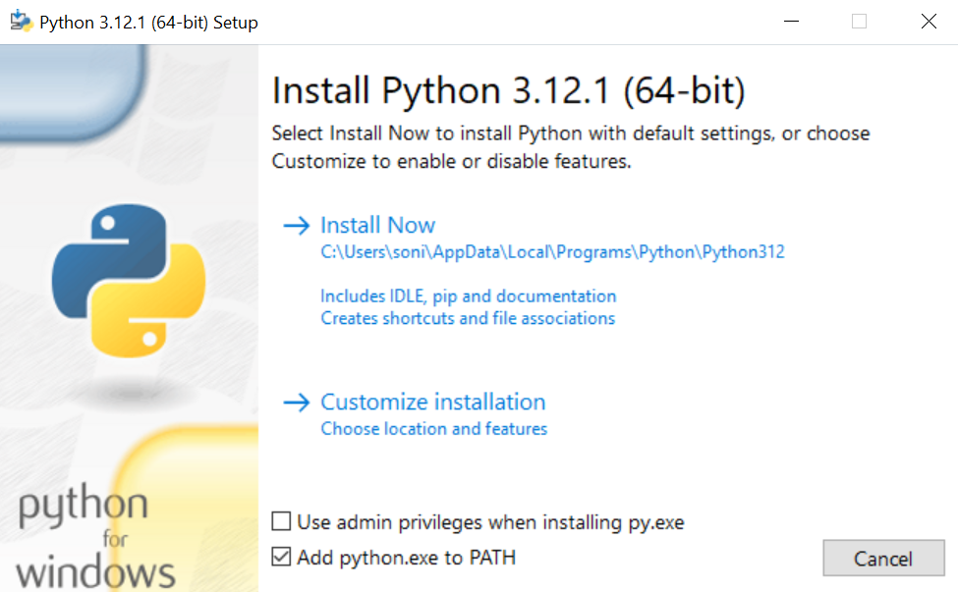
Install Python on Windows
Download Python
Go to the official Python website at https://www.python.org/downloads/
Click on the download link for the latest Python version for Windows.
Install Python
Open the downloaded .exe -file to start the installation.
Click “Add python.exe to PATH” and click “Install Now”
Restart your computer
Check that python has been installed correctly
Go to the command prompt and type: python --version
The output should be like this:

Slide 5
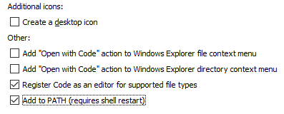
Download and Install Visual Studio Code
Download VS Code for Windows
Visit the official Visual Studio Code website at https://code.visualstudio.com/
Click on the “Download for Windows” button. It will download an .exe-file.
Install VS Code
Open the downloaded .exe file. This will start the installation. Choose these settings:
… then restart your computer

Slide 6
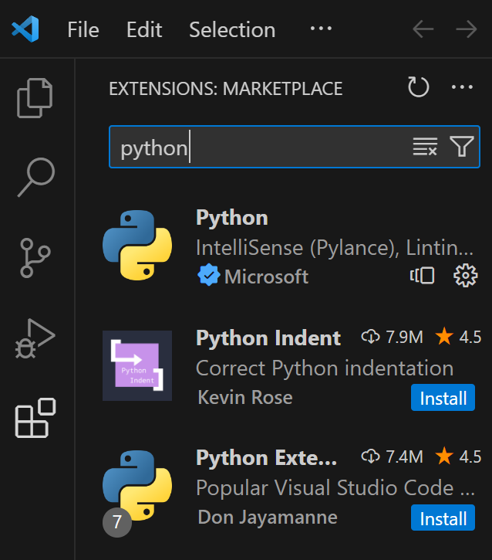
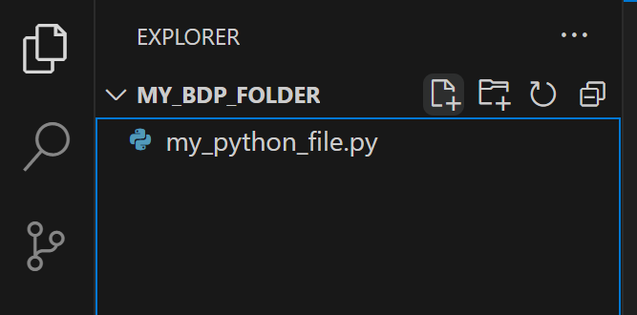
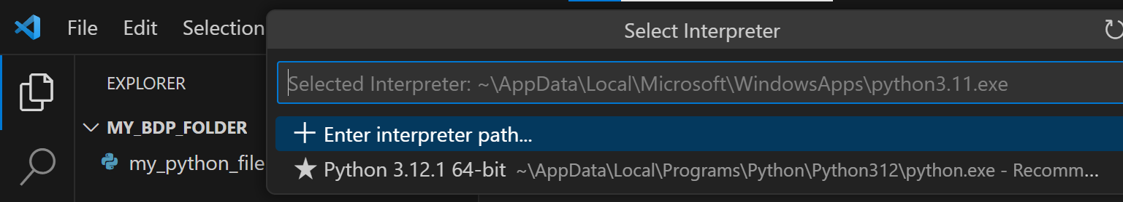
Configure Python in VS Code
Setting up Python in VS Code
Open VS Code
Launch Visual Studio Code.
If prompted, select “In a Trusted Window” and add the folder you created for your notebooks to the trusted paths. Then close the “trusted”-tab (not the VSCode application itself)
Install the Python Extension
Click on the Extensions view icon on the Sidebar or press Ctrl + Shift + X.
Search for Python and select the one published by Microsoft.
Click Install.
Select Python Interpreter
Once the extension is installed, navigate to the “files”-tab
Click on the “Open Folder” button and choose the folder you made in the beginning
Make a new python file in the folder by clicking the file+-icon
Name the file anything you like, but remember to end it with .py
A prompt may appear asking you to select a Python interpreter. If not, open the Command Palette (Ctrl + Shift + P) and type Python: Select Interpreter.
Choose the Python version you installed earlier
Test Python Setup
In your new file you can now test your python setup
Type a simple Python command, like print("Hello, world!").
Right-click in the file and select Run Python File in Terminal to execute the script. The terminal in the bottom should now print “Hello World!”

Slide 7
Additional Resources and Links
VS Code Documentation: https://code.visualstudio.com/docs
Python Documentation: https://docs.python.org/3/

